Slide 1
Circuit Switching and Packet Switching

Slide 2
Switched Communications Networks
Long distance transmission from source to destination is typically achieved through a network of intermediate switching nodes
Switching nodes are not concerned with content of data, rather they provide a switching facility that will move the data from node to node until they reach their destination.
Fig illustrates a simple switched network.

Slide 3
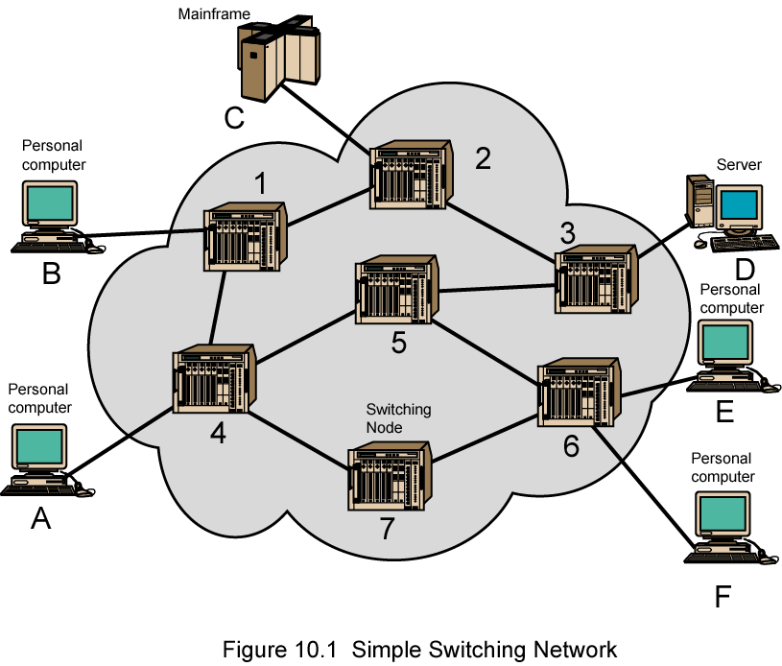
Simple Switched Network

Slide 4
Simple Switched Network
End devices attached to the network are referred as end stations
  Computers, terminals, telephones etc.
A collection of nodes and connections is a communication network
The purpose of switching device is to provide communication as nodes
Nodes are connected in some topology by transmission links.
Each station attaches to a node and the collection of nodes is referred to as a communications network.

Slide 5
Simple Switched Network
In switched communications network, data entering the network from a station are routed to the destination by being switched from node to node
Nodes may connect to other nodes only and such nodes do switching only.
some nodes are connected to stations and other nodes.such nodes accept and deliver data to the attached devices
Node-station links are generally dedicated point-to-point ;Node to node links usually multiplexed using either FDM or TDM

Slide 6
Simple Switched Network
Node to node links are usually multplexed ,using either FDM or TDM
Network is usually partially connected.i.e no diresct path between some nodes
No direct link between every possible pair of nodes.Some redundant connections are desirable for reliability
Two different switching technologies
  Circuit switching
  Packet switching

Slide 7
Circuit Switching Networks
There is a dedicated communication path between two stations
The path is a connected sequence of links between network nodes.
On each physical link, a logical channel is dedicated to the connection.
Communication via circuit switching involves three phases:
  Circuit Establishment
  Data Transfer
  Circuit Disconnect
Must have switching capacity and channel capacity to establish connection
Must have intelligence to work out routing

Slide 8
Circuit Switching Networks
Circuit Establishment
  Before any signals can be transmitted ,an end-to-end (station-to-station) circuit must be established.
Data Transferred
  Once the connection is established,data can be transferred from source to destination.
  Transmission may be analog or digital depending on the nature of the network
  Generally the connection is full duplex.
Circuit Disconnect
  After some period of data transfer ,the connection is terminated.
  Usually by the action of one of the two stations
  Dedicated resources are deallocated by sending the signals

Slide 9
Circuit Switching
Inefficient
  Channel capacity is dedicated for the duration of a connection,even if no data are being transferred.
  If no data, capacity wasted
Set up (connection) takes time which is caused by signal transfer for call establishment.
Once the circuit is established the network is effectively transparent to the users.
Information is transmitted at a fixed data rate
No delay other than the propagation delay through the transmission links.
Delay at each node is negligible.
Developed for voice traffic (phone)

Slide 10
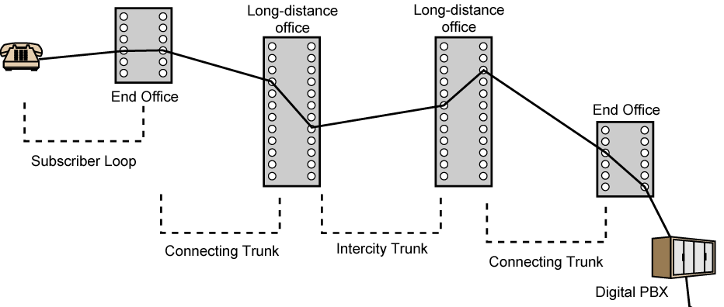
Public Circuit Switched Network

Slide 11
Public Telecommunications Networks
A collection of national networks interconnected to form the international service.
Architectural components of public telecommunication network:
  Subscriber
    Devices attached to network
  Subscriber line
    Link between the subscriber and the network.
    Also called as Local Loop or Subscriber loop
    Twisted pairs are used .
    Length of loop is few km up to few tens of km
  Exchange
    Switching centers in the network
    End office :switching centers that directly supports subscribers
  Trunks
    Branches between exchanges; will be Multiplexed

Slide 12
Public Telecommunications Networks
Subscribers connect directly to an end office.
End office switches the traffic between subscribers and between a subscriber and other exchanges.
Other exchanges are responsible for routing and switching traffic between end offices.

Slide 13
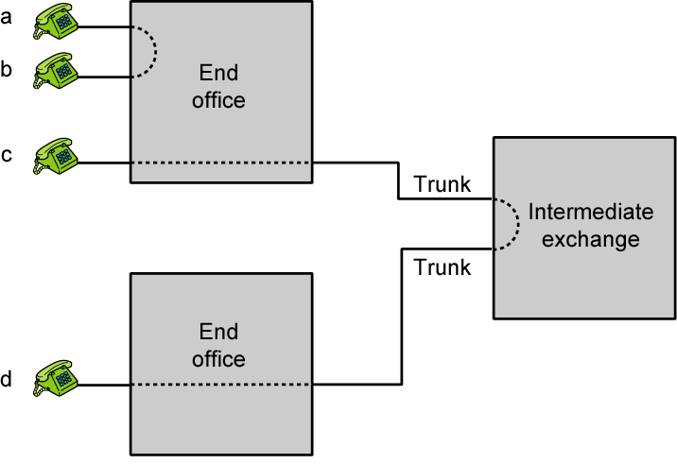
Circuit Establishment

Slide 14
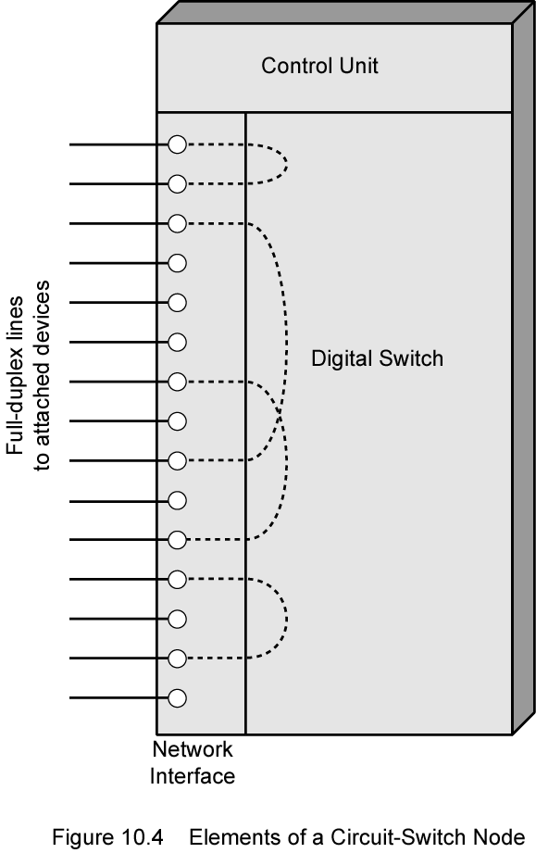
Circuit-Switch Elements

Slide 15
Circuit Switching Elements
Digital Switch
  Provide transparent signal path between any pair of attached devices
  Connection will allow full-duplex transmission
Network Interface
  Represents the functions and hardware needed to connect digital devices such as data processing devices and digital telephones to the network.

Slide 16
Circuit Switching Elements
Control Unit
  Performs three tasks
  Establish connections
    Generally on demand i.e. at the request of an attached device
    Handle and acknowledge requests
    Determine if destination is free
    construct path through the switch
  Maintain connection
  Disconnect

Slide 17
Blocking or Non-blocking
Another imortant characteristic of a circuit switching device is whether it is blocking or non-blocking
Blocking
  Occurs when a network is unable to connect stations because all paths between them are already in use
  A blocking network is one in which blocking is possible
  Used on voice systems
    Short duration calls
Non-blocking
  Permits all stations to connect (in pairs) at once
  Grants all possible connection requests as long as the called party is free.
  Used for some data processing devices

Slide 18
Two switching techniques internal to a single circuit-switching node:
    Space division switching
    Time division switching

Slide 19
Space Division Switching
Developed for analog environment( now used for digital also)
Space division switch is one in which the signal paths are physically separate from one another(divided in space)
Each connection requires a establishment of a physical path between two end stations
The basic building block of the switch is a metallic cross-point or semiconductor gate that can be enabled or disabled by a control unit
E.g Crossbar switch

Slide 20
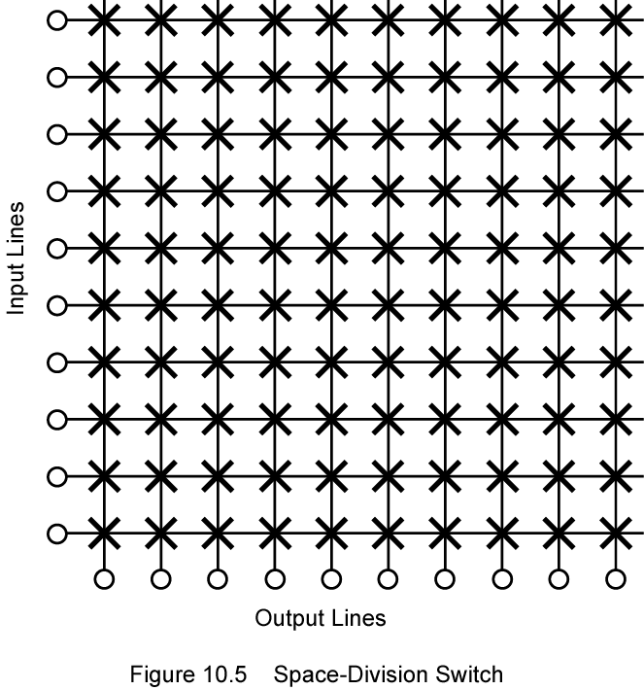
Space Division Switch

Slide 21
Space Division Switch
Crossbar matrix with 10 full-duplex I/O lines
Has 10 inputs and 10 outputs
Each station attaches to the matrix via one input and one output line
Interconnection is possible between any two lines by enabling the appropriate cross point.
100 cross points are required.

Slide 22
Space Division Switch
Limitations of Crossbar switch
  Number of crosspoints grows as square of number of stations
  Loss of crosspoint prevents connection between the two devices whose lines intersect at that crosspoint.
  Inefficient use of crosspoints
    Even when all stations are connected, only a few crosspoints in use
  Non blocking

Slide 23
Multistage Switch
Reduced number of crosspoints,increasing crossbar utilization
More than one path through network to connect to two end points ,increasing reliability
Requires a more complex control scheme.
May be blocking

Slide 24
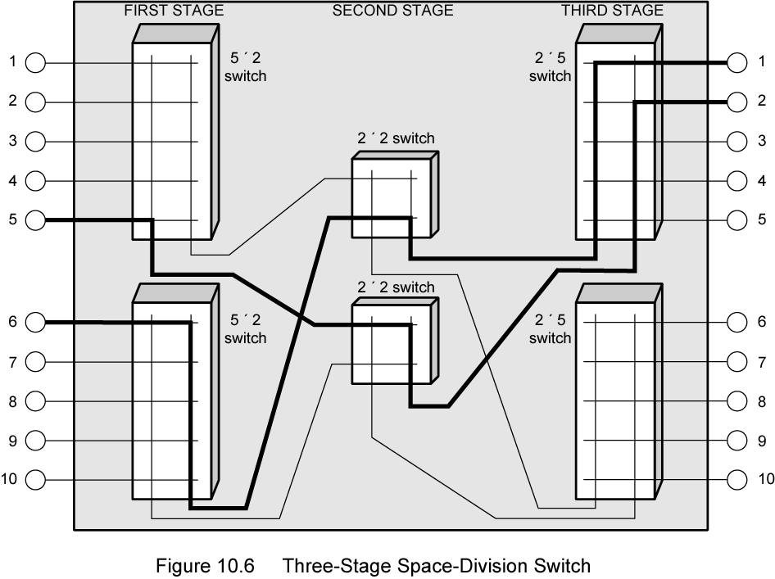
Three Stage Space Division Switch

Slide 25
Time Division Switching
Modern digital systems rely on intelligent control of space and time division elements
Use digital time division techniques to set up and maintain virtual circuits
Partition lower- speed bit stream into pieces that share a higher speed stream with other bit streams.
The individual pieces or slots ,are manipulated by control logic to route data from input to output.

Slide 26
Packet Switching Principles
Circuit switching designed for voice
  Resources dedicated to a particular call
  Much of the time a data connection is idle
  Data rate is fixed
    Both ends must operate at the same rate

Slide 27
Basic Operation of packet switching
Data transmitted in small packets
  Upper bound of packet length is typically 1000 octets(bytes)
  Longer messages split into series of packets
  Each packet contains a portion of user data plus some control information
Control information
  Routing (addressing) info
Packets are received, stored briefly (buffered) and past on to the next node
  Store and forward

Slide 28
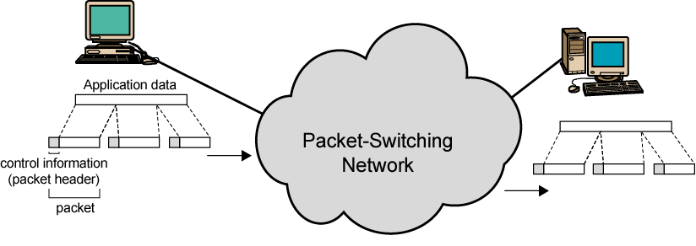
Use of Packets

Slide 29
Advantages
Line efficiency
  Single node to node link can be shared by many packets over time
  Packets queued and transmitted as fast as possible
Data rate conversion
  Each station connects to the local node at its own speed
  Nodes buffer data if required to equalize rates
Packets are accepted even when network is busy
  Delivery may slow down
Priorities can be used

Slide 30
Switching Technique
Station breaks long message into packets
Packets sent one at a time to the network
Packets handled in two ways
  Datagram
  Virtual circuit

Slide 31
Datagram
Each packet treated independently
Packets can take any practical route
Packets may arrive out of order
Packets may go missing
Up to receiver to re-order packets and recover from missing packets

Slide 32
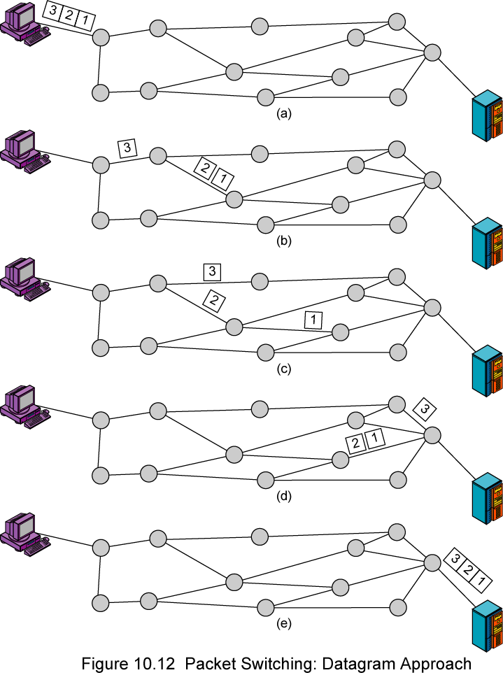
Datagram
Diagram

Slide 33
Virtual Circuit
Preplanned route established before any packets sent
Call request and call accept packets establish connection (handshake)
Each packet contains a virtual circuit identifier instead of destination address
No routing decisions required for each packet
Clear request to drop circuit
Not a dedicated path

Slide 34
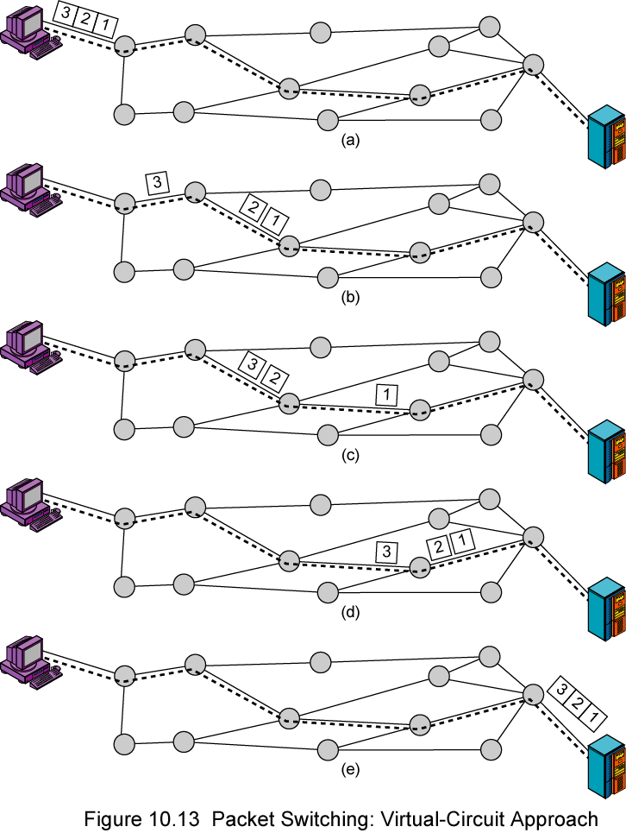
Virtual
Circuit
Diagram

Slide 35
Virtual Circuits v Datagram
Virtual circuits
  Network can provide sequencing and error control
  Packets are forwarded more quickly
    Each packet contains a virtual circuit identifier
    No routing decisions to make
  Less reliable
    Loss of a node looses all circuits through that node
Datagram
  No call setup phase
    Better if few packets
  More flexible
    Routing can be used to avoid congested parts of the network
  More reliable

Slide 36
Effect of packet size on transmission time
Significant relationship between packet size and transmission time as shown in fig.
In this example ,it is assumed that there is a virtual circuit from station X through a and b to station Y.
The message comprises of 40 octets
Each packet has 3 octets of control information which is placed at the beginning of each packet
Entire message is 43 octets

Slide 37
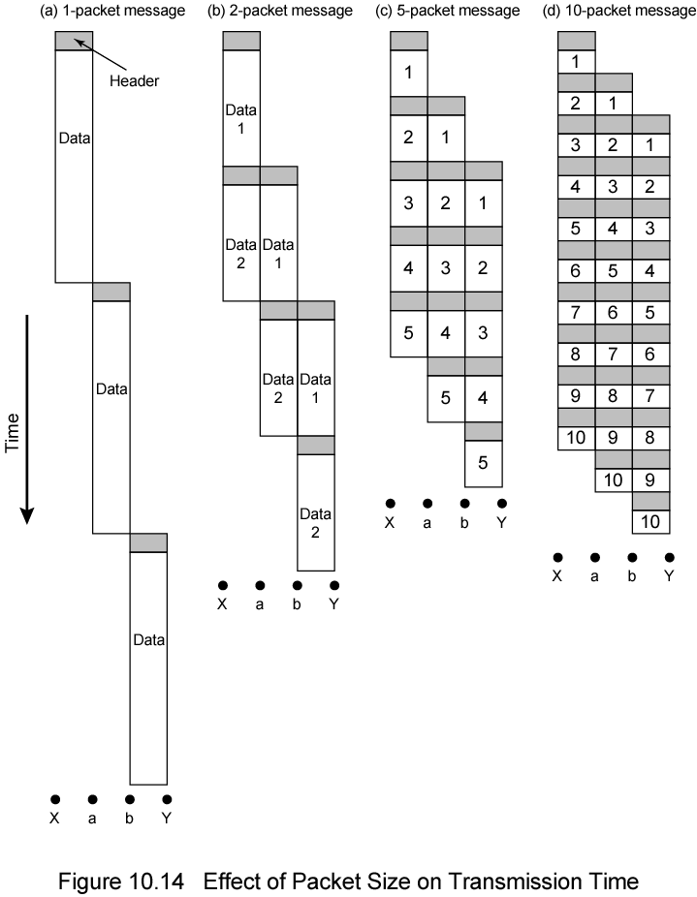
Packet Size

Slide 38
Circuit vs Packet Switching
Performance
  Propagation delay
    The time it takes a signal to propagate from one node to the next
  Transmission time
    The time it takes for a transmitter to send out a block of data
  Node delay
    The time it takes for a node to perform the necessary processing as it switches data

Slide 39
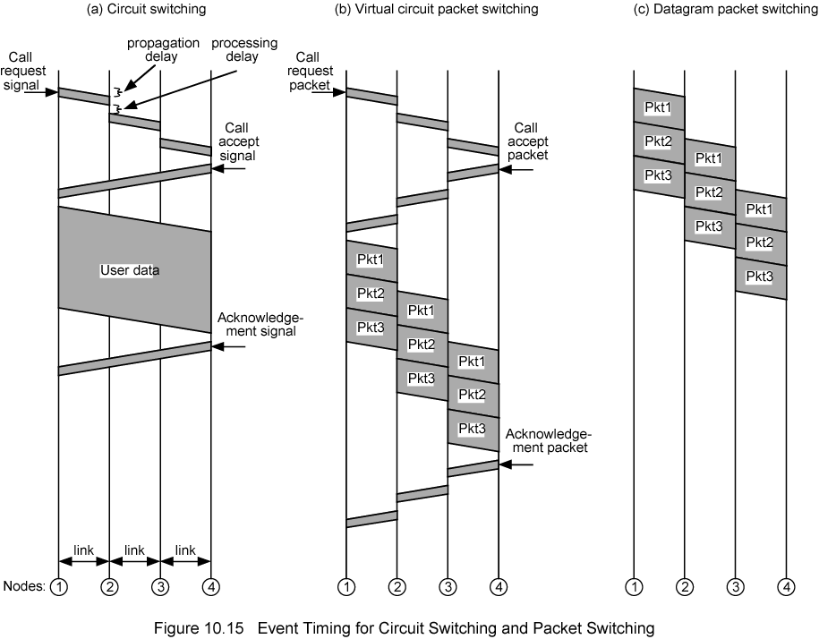
Event Timing

Slide 40
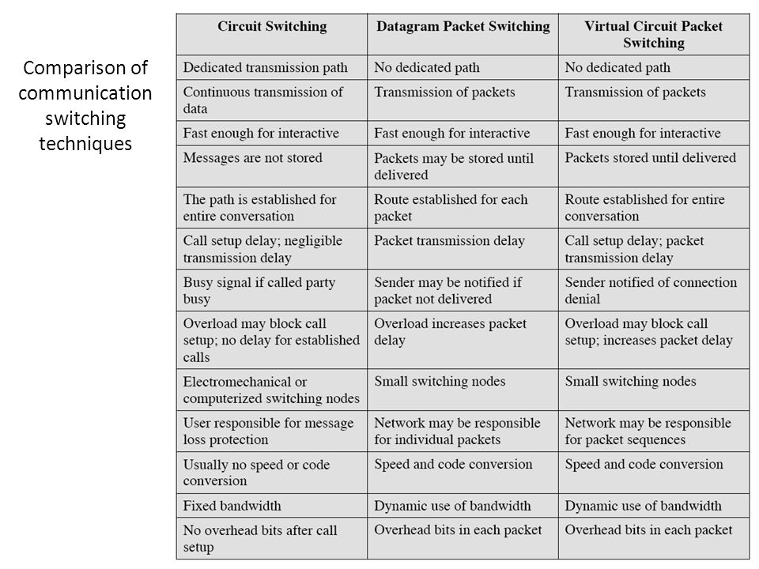
Comparison of communication switching techniques

